Slide 1


UD 2
DESCRIPTIVE
STATISTICS
1

Slide 2
GENERAL CONCEPTS
POPULATION
  Set of objects that we are interested in, for which we intend to get conclusions.
  Example: All pieces that are going to be assembled by means of a certain industrial process.
SAMPLE
  Subset formed by parts of the objects (individuals) of a population.
  Example: 20 pieces produced by the industrial process.
sampling
sample
Population
Conclusions
(statistical reasoning)
The sample must be “representative” of the population.
Only guarantee of “representativity”: Random sampling.
2

Slide 3
OBJECT OF SAMPLING
  To know the population, by analyzing one sample.
  STATISTICAL INFERENCE
  Process of reasoning to obtain conclusions (with a known margin of error) about the population, by analyzing samples extracted from the population.
3

Slide 4
EXAMPLES OF POPULATIONS
Does the population exist? YES
- Intention of voting of spaniards in a General Election in Spain.
- Development of a certain pathology in buildings in Valencia.
Partially
  - No. of laptop batteries that are sold every day at a computer store.
  - No. of errors in the invoices of the Account Department of the company.
No
  - Resistance of a new type of polymer.
  - Study to investigate if a dice is correct or not.
  - In any experiment in a laboratory
  The size of populations is usually large, but not always:
  - Population of countries in the European Union
4

Slide 5
The results of any process always present VARIABILITY
INPUTS
OUTPUTS
PROCESS
  All real populations have variability. That is, it is not possible to have two identical pieces.
RANDOM VARIABLE
  It is any characteristic, that can be expressed numerically, that fluctuates among the individuals of the population.
  Example: the length of a piece.
5

Slide 6
Types of RANDOM VARIABLES
Nature
  QUALITATIVE
  QUANTITATIVE
Number of characteristics
  ONE-DIMENSIONAL
  K-DIMENSIONAL
Set of values
  DISCRETE
  CONTINUOUS
6

Slide 7
ONE-DIMENSIONAL FREQUENCY TABULATION
DISCRETE VARIABLE:
Absolute frequency
Digits chosen
No. occurrences
Relative frequency
(X
)
(n
)
f
=n
/N
i
i
i
i
0
0
0
1
2
0.06
2
6
0.18
3
7
0.21
4
9
0.26
5
4
0.12
> 5
6
0.18
N=34
7

Slide 8
CONTINUOUS VARIABLE:
Frequency tabulation
Resistance of a polymer (Nw)
---------------------------------------------------------------------------------------------------------------------------------------
Lower Upper Relative Cumulative Cum. Rel.
Class Limit Limit Midpoint Frequency Frequency Frequency Frequency
---------------------------------------------------------------------------------------------------------------------------------------
at or below 10.00 0 .00000 0 .00000
1 10.00 15.00 12.50 0 .00000 0 .00000
2 15.00 20.00 17.50 1 .00610 1 .00610
3 20.00 25.00 22.50 9 .05488 10 .06098
4 25.00 30.00 27.50 18 .10976 28 .17073
5 30.00 35.00 32.50 26 .15854 54 .32927
6 35.00 40.00 37.50 38 .23171 92 .56098
7 40.00 45.00 42.50 34 .20732 126 .76829
8 45.00 50.00 47.50 20 .12195 146 .89024
9 50.00 55.00 52.50 9 .05488 155 .94512
10 55.00 60.00 57.50 5 .03049 160 .97561
11 60.00 65.00 62.50 0 .00000 160 .97561
12 65.00 70.00 67.50 3 .01829 163 .99390
13 70.00 75.00 72.50 1 .00610 164 1.0000
---------------------------------------------------------------------------------------------------------------------------------------
Mean = 39.3288 Standard Deviation = 9.46009 Median = 39.1 N=164
8

Slide 9
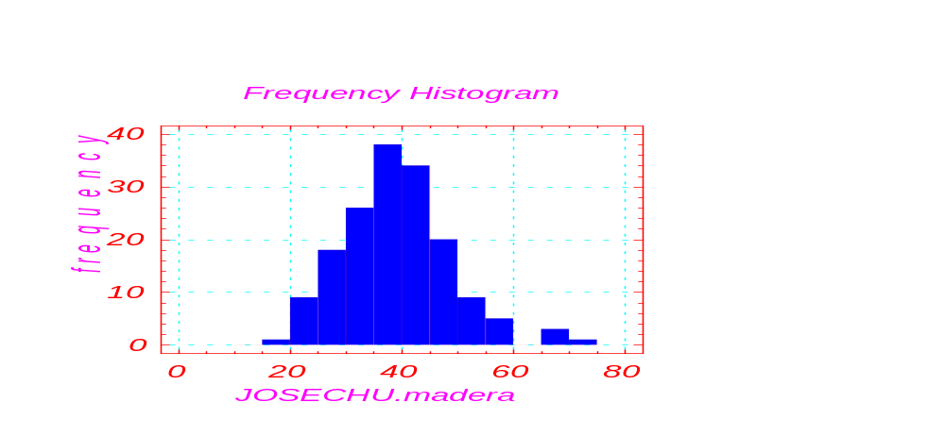

HISTOGRAMS
It is a graphical representation of one set of data (minimum 40-50 data) (frequency diagram)
Is this absolute
or relative
frequency?
9
Is this a symmetric distribucion?

Slide 10

Abnormal frequency of one interval
(systematic error in data recording)
Asymmetric histogram
Truncated data
10

Slide 11
Mixture of populations
Population A
Population B
Histogram of 2 different populations
11

Slide 12
Continuous random variables:
Density function.
Example: time (sec.) required by algorithm to invert a matrix
Sample = 40
0.10
0.15
0.40
0.20
0.15
sec
20
30
40
50
60
70
Dark area = 0.15
sec
30
40
Probability (30<X<40) = 0.15
Dark area = 0.15
Area under the curve = 1
sec
30
40
12

Slide 13
Parameters of Position and Dispersion of one random variable
Different position. Same dispersion.
Different dispersion. Same position.
Different dispersion. Different position.
13

Slide 14
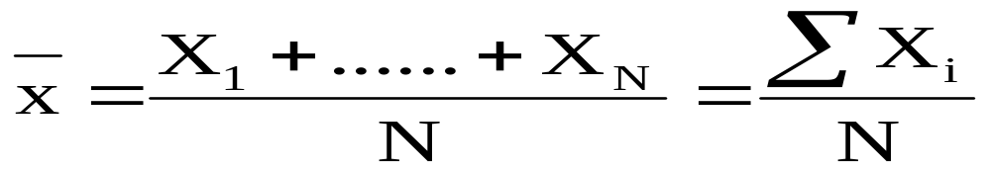

PARAMETERS OF POSITION
AVERAGE
(mean)
Sample mean
Population mean: m (or μ )
In case of asymmetric data or outliers,
the MEDIAN is better parameter of position than the mean.
14

Slide 15
MEDIAN
  If N even: Average of values in the position N/2, (N/2) + 1
  If N odd: Value in the position (N+1)/2
Percentile 30 = Z₃₀
P(X<Z₃₀) = 0.3
1st quartile (Q1) = Z₂₅
P(X<Q1) = 0.25
3rd quartile (Q3) = Z₇₅
P(X<Q3) = 0.75
0.5
0.25
Z₅₀
Z₇₅
15

Slide 16


CALCULATION OF MEDIAN AND QUARTILES
- Take all data
- Sort data in increasing order
(N+1)/2
order 1 2 3 4 5 6 7 8 9
Resistance 155 169 175 185 191 203 207 225 230
Nº cars 2 3 3 4 4 4 6 9 13
Q₁
median
Q₃
N/2
(N/2)+1
Order 1 2 3 4 5 6 7 8 9 10
Resistance 155 169 175 185 191 203 207 225 230 400
197
Nº cars 2 3 3 4 4 4 6 9 13 23
Q₁
4
Q₃
16
See formulary table for exact calculation of Q₁, Q₃

Slide 17
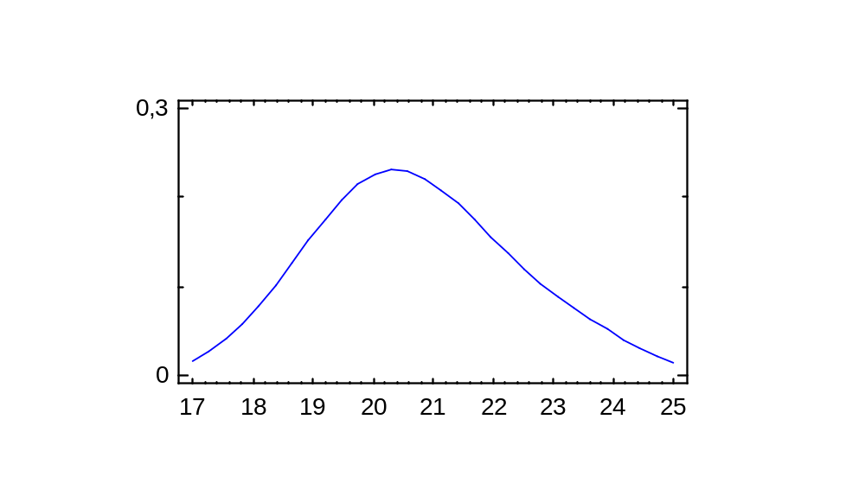
relative maximum
average
mode
median
P (X<median) = 0.5
Same value in a Normal distribution
17

Slide 18
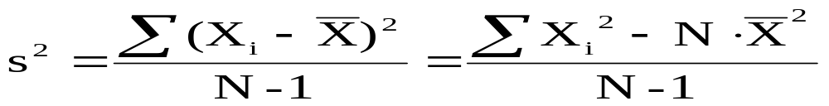
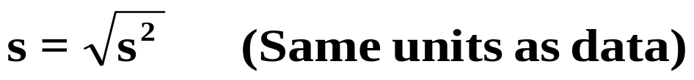
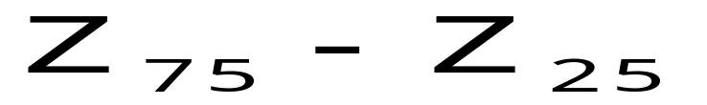

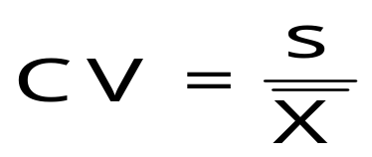
PARAMETERS OF DISPERSION
VARIANCE:
STANDARD DEVIATION
INTERQUARTILE RANGE:
= Q3 – Q1
RANGE:
COEFFICIENT OF VARIATION
(non-dimensional)
18

Slide 19







If m=10, s=3, is the dispersion high or low?
68.27%
95.45%
99.73%
19

Slide 20
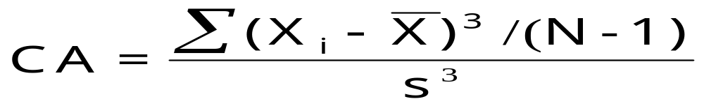
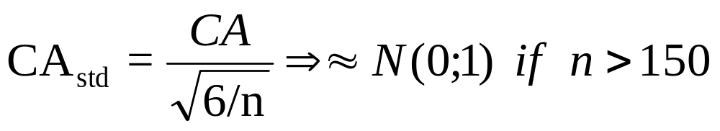
COEFFICIENT OF ASIMMETRY (SKEWNESS):
- CA = 0
- CA > 0
average
median
- CA < 0
average
median
20

Slide 21
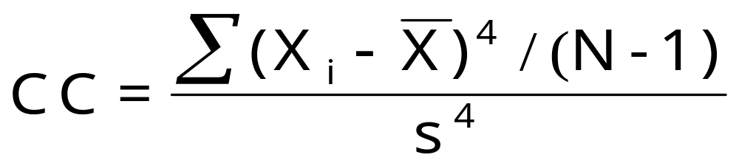
KURTOSIS COEFFICIENT
-3
CC=3 (=0) NORMAL DISTRIBUTION
CC>3 (>0) LEPTOKURTIC DATA (e.g. Student’s t); OUTLIERS?
CC<3 (<0) PLATIKURTIC DATA. CENSORED DATA?
21

Slide 22
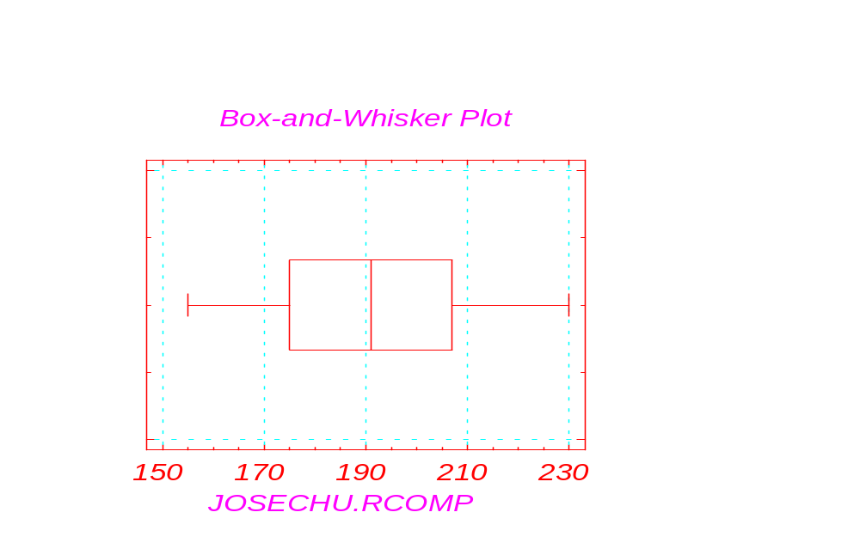
BOX-WHISKER DIAGRAM
Sample size 9
Average 193.333
Median 191
Mode 191
Geometric mean 191.859
Variance 637.5
Standard deviation 25.2488
Standard error 8.4162
Minimum 155
Maximum 230
Range 75
Lower quartile 175
Upper quartile 207
Interquartile range 32
Skewness 0.0700
Standardized skewness 0.0858
Kurtosis -0.9567
Standardized kurtosis -0.5858
------------------------------------
22

Slide 23
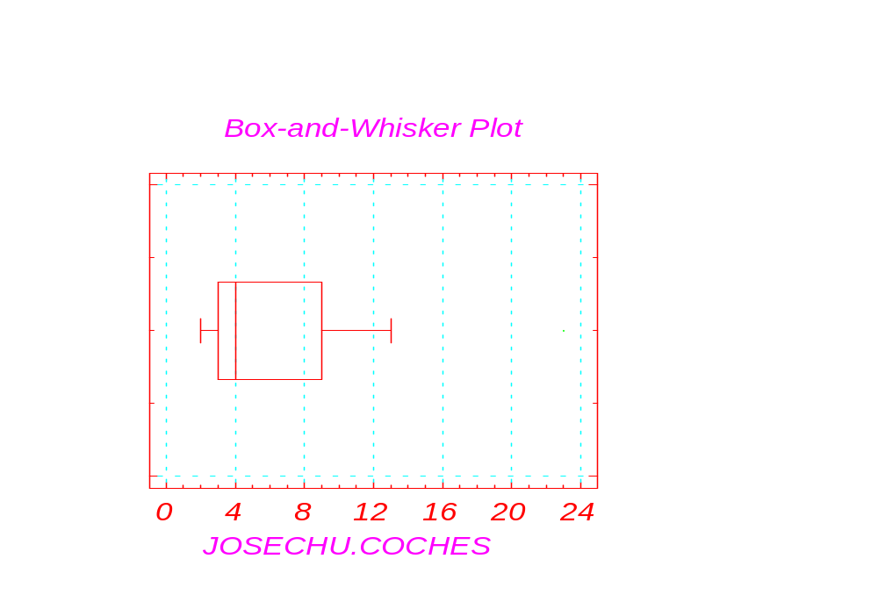
Variable: JOSECHU.COCHES
-------------------------------
Sample size 10
Average 7.1
Median 4
Mode 4
Geometric mean 5.33276
Variance 42.3222
Standard deviation 6.50555
Standard error 2.05724
Minimum 2
Maximum 23
Range 21
Lower quartile 3
Upper quartile 9
Interquartile range 6
Skewness 1.95257
Standardized skewness 2.52076
Kurtosis 3.78297
Standardized kurtosis 2.4419
--------------------------------
23

Slide 24
Box-Whisker Diagram
1,5 IQR
1,5 IQR
average
IQR
X
Q1
Q3
median
- The “box” comprises 50% of values, from the 1st to 3rd quartile
- The central line corresponds to the median
- The “whiskers” extend from the lowest to the highest observed value except if their distance to the nearest quartile is higher than 1.5 · IQR
24

Slide 25
Box-Whisker Diagram
- Those extreme values that differ from the nearest quartile more than 1.5 IQR are plotted as isolated points to highlight that they might be outliers.
Outlier: an abnormal datum that does not belong to the same
population, “it lies out” of the rest. They are usually eliminated.
Not all isolated points are outliers !!
In a Normal distribution, isolated points in the box-whisker plot
“quite close” to the end of a whisker are not outliers.
(check this by simulating 1000 Normal data with Statgraphics)
To check if a high value in a positive skewed distribution is
an outlier: represent data on a Normal Probability Plot using
transformations: X^{0.5} ; X^{0.25}; log(x)
(check this by simulating 100 Chi² data with Statgraphics)
25

Slide 26
1
GENDER
2
150
160
170
180
190
200
HEIGHT
Is there any outlier in women’s data?
Calculate the interquartile range of men’s height
Calculate the range of women’s height
Is the distribution of men’s data asymmetric? Positive / negative?
26

Slide 27
EXERCISE: draw a box-whisker plot with the following data:
16; 8; 90; 22; 2; 50; 5; 30; 11
(check formula table for the exact value of Q1 and Q3)
Calculate the range and the interquartile range
Describe the distribution (symmetric, CA>0, CA<0)
Is there any outlier that should be discarded?
Plot data on a Normal Probability Plot
Use transformations: X^{0.5} ; X^{0.25}; log(x)
Change 90 by 500; is it an outlier?
27

Slide 28
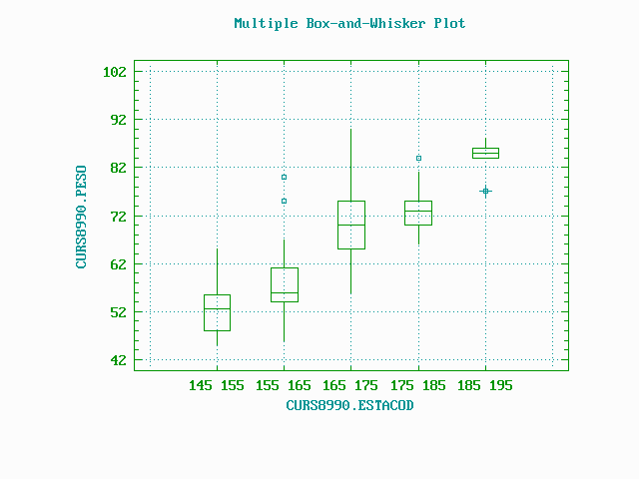
WEIGHT
HEIGHT
28

Slide 29
40
BARCHART
30
frequency
20
10
0
Spain
France
England
Italy
Ireland
7,09%
PIECHART
18,90%
14,96%
Spain
France
England
Italy
Ireland
27,56%
31,50%
29

Slide 30


TWO-DIMENSIONAL
DESCRIPTIVE STATISTICS
30

Slide 31
TWO-DIMENSIONAL RANDOM VARIABLES
WHEN TWO RANDOM NUMERIC CHARACTERISTICS ARE OBSERVED FROM EACH INDIVIDUAL, WE HAVE A TWO-DIMENSIONAL RANDOM VARIABLE.
X
174
169
183
168
Y
184
178
167
186
EXERCISE
Are these 2 one-dimensional variables
or one two-dimensional variable?
- length of pieces from supplier A (X) and supplier B (Y)
- In a married couple, the height of husband (X) and wife (Y)
- The height of students from Valencia (X) and Madrid (Y)
31
- Time (ms) taken by algorithm X and Y to invert different matrixes

Slide 32
TWO-DIMENSIONAL VARIABLES:
CONTINGENCY TABLES
- THEY ALLOW TO STUDY THE RELATIONSHIP BETWEEN THE TWO COMPONENTS
  - IF ONE OF THE VARIBLES IS CONTINUOUS, IT WILL BE REGROUPED IN INTERVALS.
REPEAT
Row
YES
NO
Total
gender
5
41
  Relative frequency of repeat conditioned to gender
MALE
10.9
89.1
1
24
FEMALE
4.0
96.0
COLUMN
6
65
71
  Marginal frequency of repeat
TOTAL
8.5
91.5
32

Slide 33
REPEAT
Row
YES
NO
Total
GENDER
Relative frequency of gender conditioned to repeat
5
41
46
MALE
83.3
63.1
64.8
Marginal frequencies:
  Frequency of each value of one variable without taking into account the other
Relative conditional frequencies:
  Relative frequency of the value of one variable in relation to each value of the other
1
24
25
  Marginal frequency of gender
FEMALE
16.7
36.9
35.2
COLUMN
6
65
71
TOTAL
33

Slide 34
QUALITATIVE VARIABLES:
  BY MEANS OF A CONTINGENCY TABLE.
REPEAT
YES
NO
Row
  Marginal frequency of gender
  Marginal frequency of repeat
  Relative frequency of gender conditined to repeat
  Relative frequency of repeat conditioned to gender
GENDER
1
2
Total
MALE
5
41
46
1
83.3
10.9
63.1
89.1
64.8
FEMALE
1
24
25
2
16.7
4.0
36.9
96.0
35.2
COLUMN
6
65
71
TOTAL
8.5
91.5
QUANTITATIVE VARIABLES:
  BY MEANS OF A CONTINGENCY TABLE AFTER GROUPING THE DATA IN INTERVALS.
  PROBLEM: SOME INFORMATION IS LOST IN THE TABULATION
34

Slide 35
HEIGHT
145
155
165
175
185
Row
155
165
175
185
195
Total
WEIGHT
40 55
9
17
0
0
0
26
75.0
44.7
.0
.0
.0
20.0
55 70
3
18
31
5
0
57
25.0
47.4
53.4
29.4
.0
43.8
70 85
0
3
24
12
3
42
.0
7.9
41.4
70.6
60.0
32.3
85 99
0
0
3
0
2
5
.0
.0
5.2
.0
40.0
3.8
Column
12
38
58
17
5
130
Total
9.2
29.2
44.6
13.1
3.8
100
Marginal frequency of weight
Marginal frequency of height
Relative frequency of weight conditioned to height
35

Slide 36

SCATTERPLOT
Plot of WEIGHT vs HEIGHT
95
85
75
WEIGHT
65
55
45
150
160
170
180
190
200
HEIGHT
36

Slide 37
EXERCISES:
in PoliformaT at:
recursos \ 04-ejercicios \ ejercicios resueltos \ ejercicios UD2.pdf
37

